Slide 1

Repository and Research Office Partnerships at University of Canberra

Slide 2

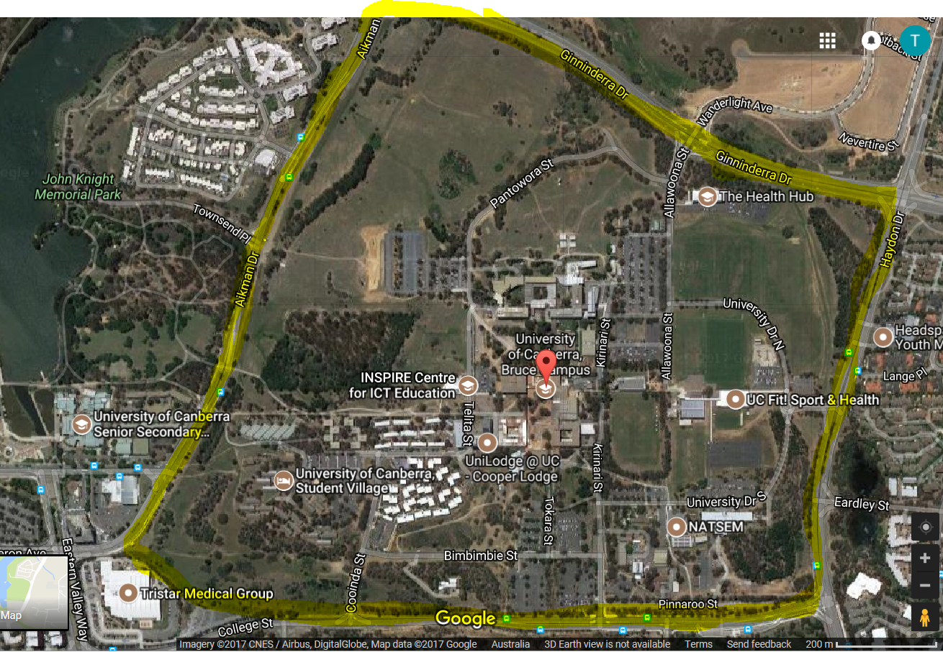
What is UC?
Building a global community of OA repositories
Launched in 2009
120 members from around the world

Slide 3
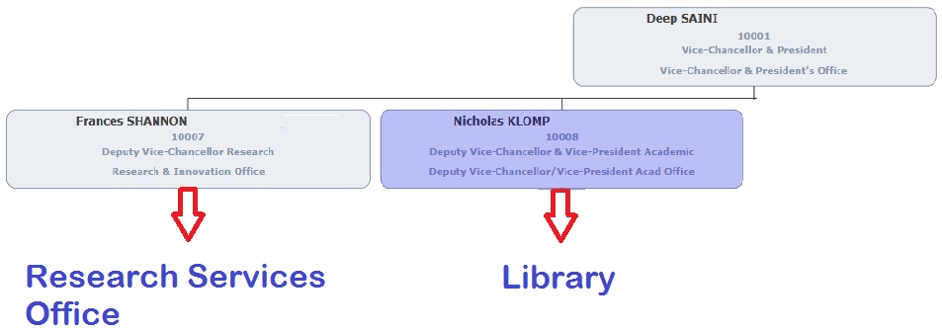

Not “same same but different”:

Slide 4
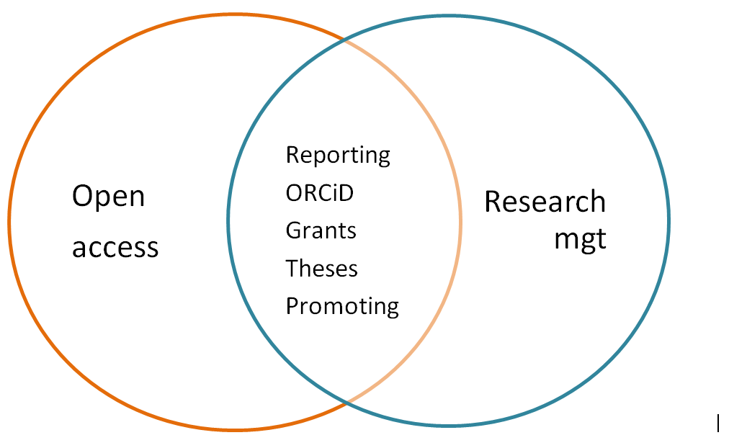
Library / Research Services Office Collaboration

Slide 5
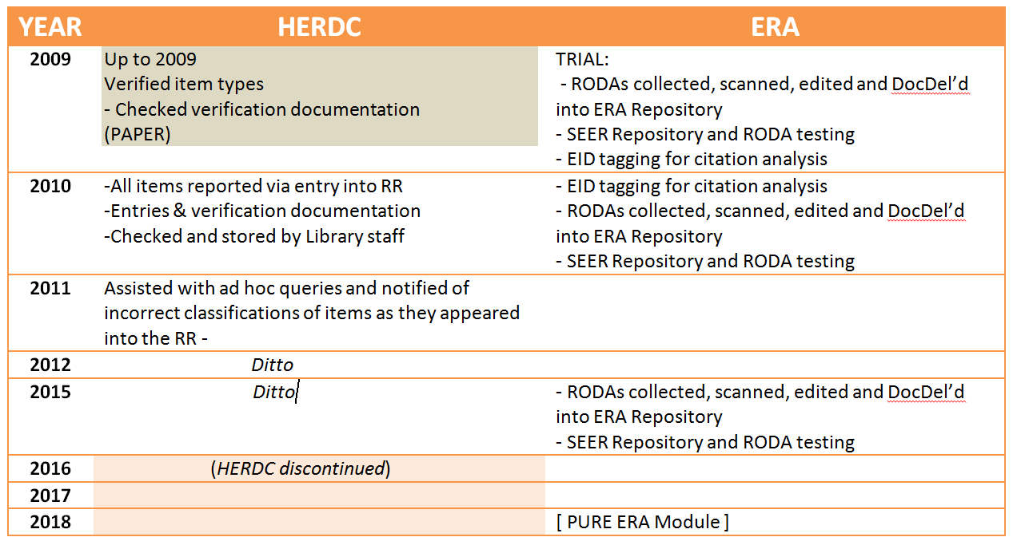
Research Reporting: [HERDC] & ERA in the Library

Slide 6
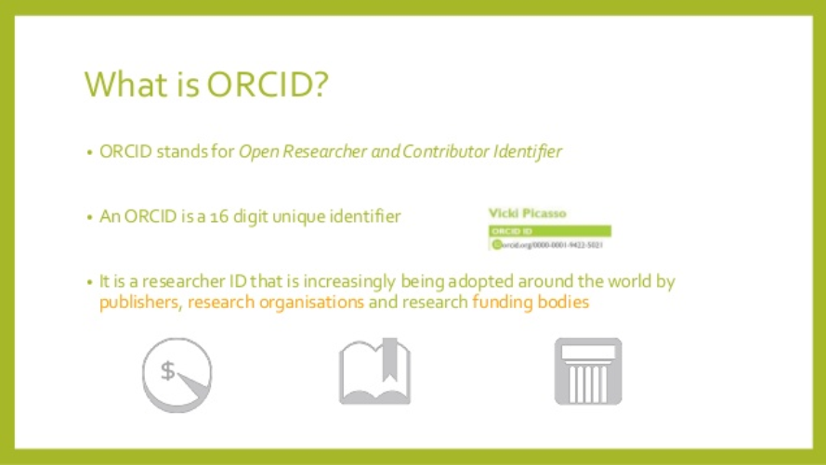
ORCiD in the Library

Slide 7
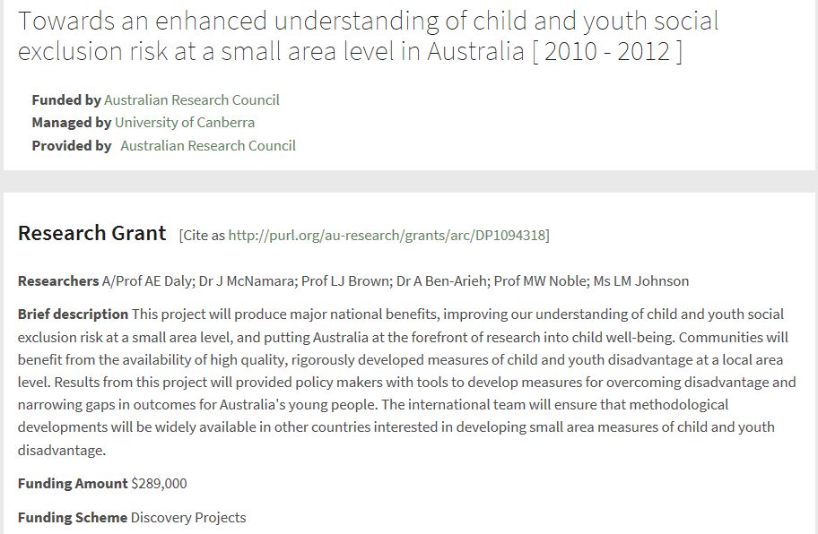
Research Grants:
OA Mandates ARC / NHMRC

Slide 8
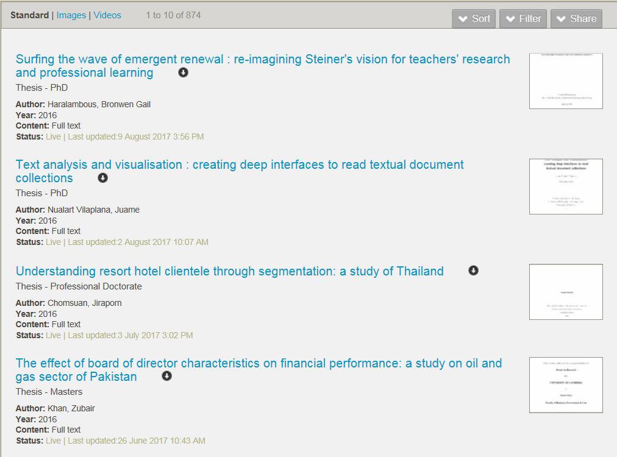
Theses: Education & Open Access

Slide 9
Promoting UC : UC Research Repository
Open Archives (USA)
OpenDOAR (UK)
ROAR (UK)
Trove (AU)
Google (US / AU) highly rated
Google Scholar
CORE (UK)
BASE (Europe)

Slide 10
Changes & Challenges:
The roles of the two offices are very different but complimentary
Our processes and roles have evolved over the 8 years I have been in this role, and will continue to do so as new requirements, tools and technologies disrupt the status quo
From my perspective the challenges have all been in-house

Slide 11
Research Services Functions
Grant management
Ethics and Integrity
Research publication collection
Reporting and performance (Publications, income, HDR)
  Individual researcher performance
  Research Institute/Faculty performance
  Institutional performance (compared to other universities)

Slide 12
Research Office and Library
University libraries play an important role in supporting research and Research Services activity
  General services for researchers
  Services that support other units
  Strategic services
    ORCiD (researcher disambiguation)
    Publication collection (could we pass an audit?)
    Research data management
    Excellence in Research for Australia

Slide 13
Excellence in Research for Australia
Full census of publications by field of research at each university
Supported by other measures such as income, patents, designs etc
Occurs every 3 (or so) years
No funding attached but of reputational importance
A massive effort in staff time and resourcing, involving all research leaders, run out of Research Services, with involvement from library

Slide 14

Pure
UC moved to Pure for Research Management in 2017
Research Services
Citation analysis, benchmarking
Researcher
Pure
Projects
Publication Collection in Pure
ARC’s SEER
Library
Pure ERA Module
Checking workflow
Pure Dark Repository
External Peer Reviewers
Scopus
Checking Content
WoS
Mendeley Pubmed and more
Open Access Repository
ORCID

Slide 15
Working collaboratively
We are on the same team (Team UC)
We respect each others skill sets and contributions to be made to achieving shared goals and resolving issues
We respect the different networks that can be brought into play to achieve shared goals
We respect that the language used and the pressures felt by the two groups may be different but we look for common ground

Slide 16


Thank you for listening
Terri Landford – terri.landford@canberra.edu.au
Sophie Holloway - Sophie.Holloway@canberra.edu.au

